Slide 1



Google BigQuery:
Introduction, Deep-Dive & Applications
TEAM 1
Harshit Arora
Patrick He
Halle Steinberg
Sean Yu

Slide 2

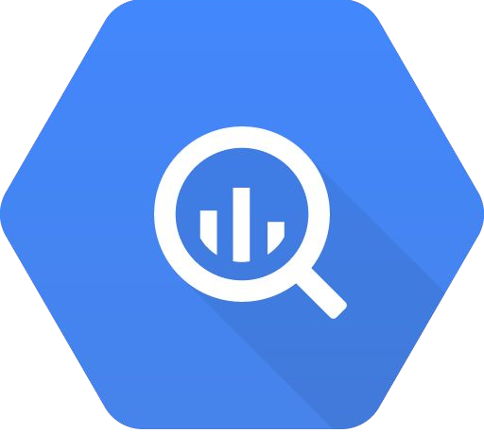




Today’s Agenda
BigQuery Overview
Set-Up and Demonstration
Application & Use-Cases
Q&A

Slide 3
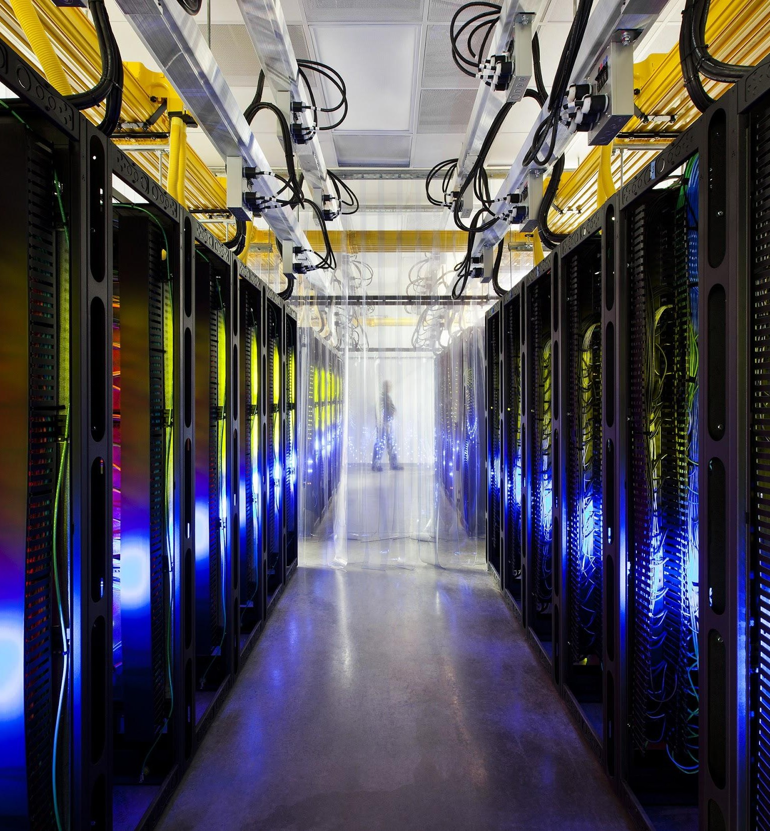
BigQuery Overview

Slide 4
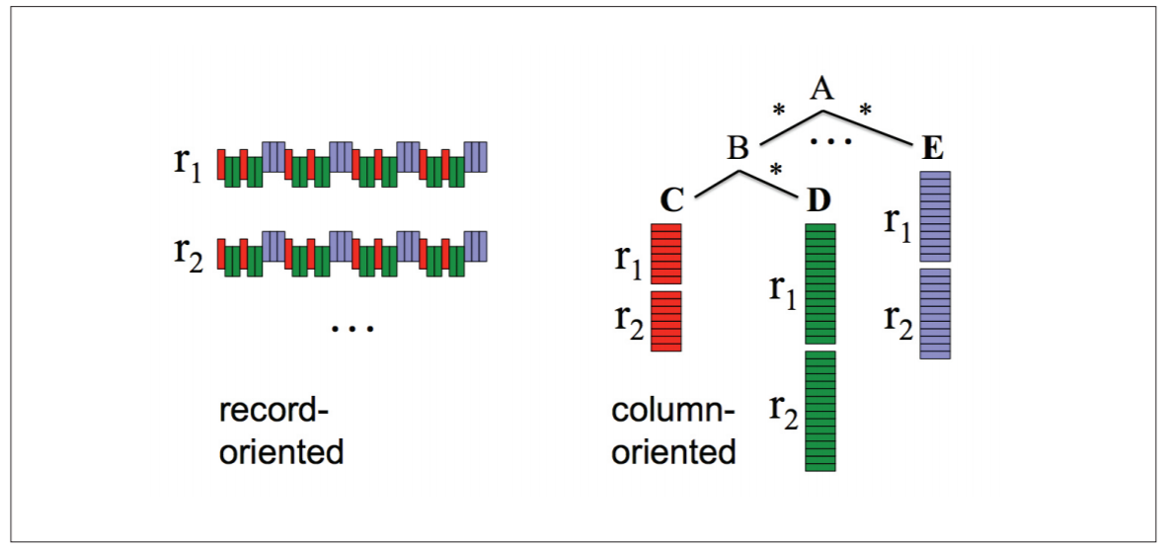
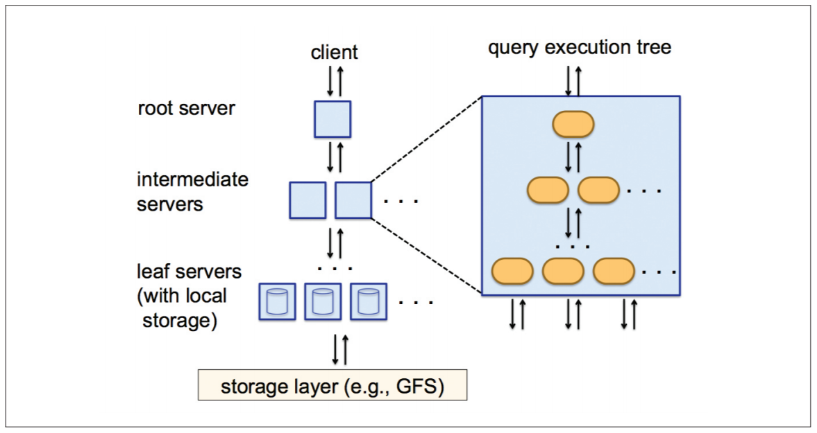

What is Google BigQuery?
Fully-managed, cloud-based interactive query service for massive datasets
Allows users to perform queries and retrieve data fast and at very low costs
BigQuery is Google's external implementation of Dremel
Core technology designed to overcome speed and performance issues
Two core technologies are responsible for Dremel's high scalability and powerful query performance
Column-oriented storage – separates each record and stores on different storage volumes
Tree architecture – quickly receive query results by forming parallel distributed trees
Dremel Columnar Storage
Dremel Tree Architecture

Slide 5
Why should we use BigQuery?
Dremel (and BigQuery) first designed to overcome issues faced due to MapReduce
MapReduce is extremely slow and inefficient with large datasets
Instantaneous results are not possible
Code is much harder to learn and understand for non-technical users
BigQuery allows users to run SQL queries on very large datasets and retrieve results in seconds
Requires only basic knowledge of SQL to perform queries – can be used by non-programmers and programmers alike
Handles structured data very well – suitable for OLAP/BI tasks
Ability to explore record-level data in real-time

Slide 6
Set-Up & Demonstration

Slide 7



Setting Up BigQuery
This top layer is a mask. To
alter the image (and delete this text box) go to “View” in the toolbar then “Master” and make adjustments there.
Right click on it, then click Order / Send to back.
Replace the photo layer, then send your photo to the back the same way.
Registering for a Google Cloud account is free, and Google provides a $300 credit for the first 12 months of set-up
In the simplest case, this credit will be utilized for storing, retrieving, and querying data on BigQuery
Setting Up a Google Cloud Account
Visit https://cloud.google.com/
Click on "Sign-In" OR "Get Started for Free"
Once signed in, click on "Console" to visit your Google Cloud dashboard
Pricing starts at:
1 TB Processing: $5 (via BigQuery)
Storage: $0.2 per GB (via Google Cloud Storage)
Generally cheaper than S3 & Amazon Athena

Slide 8
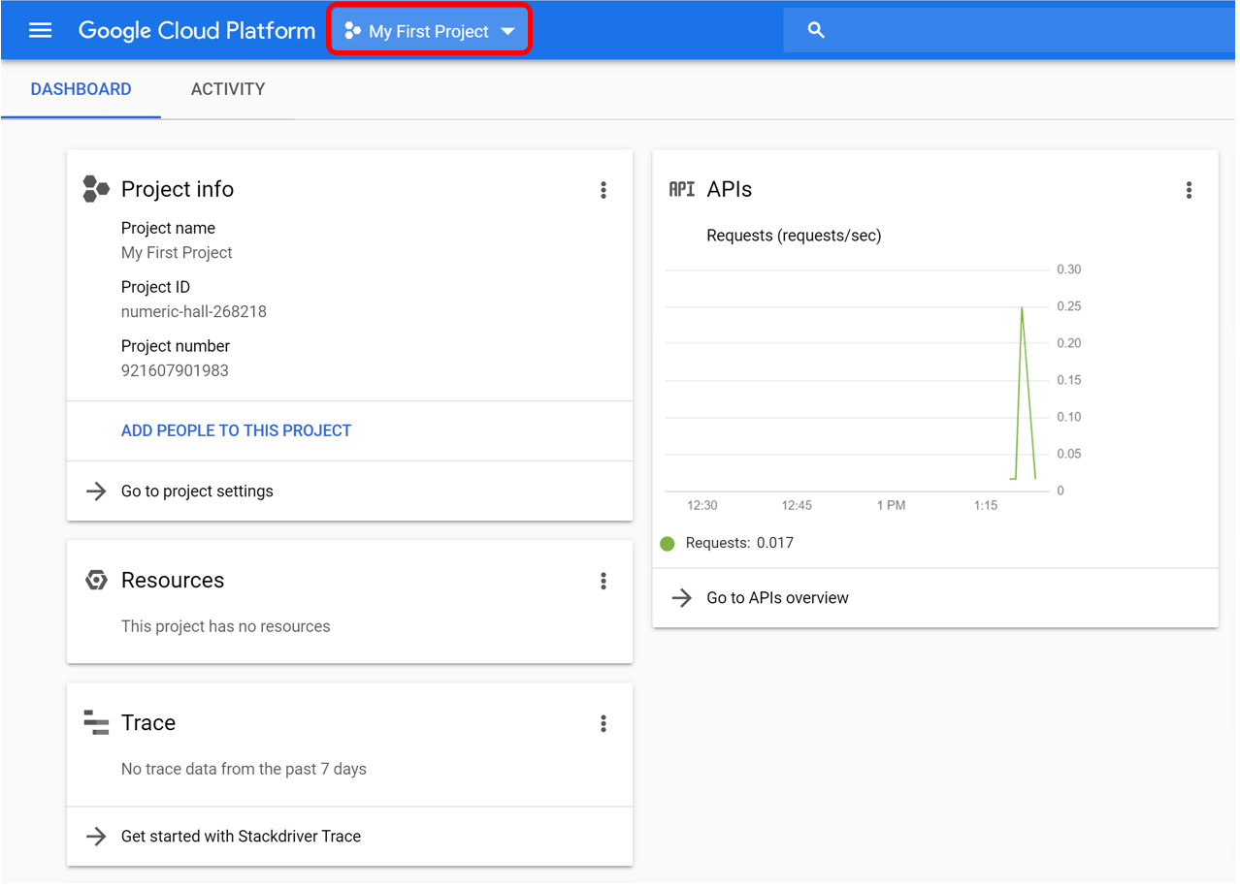
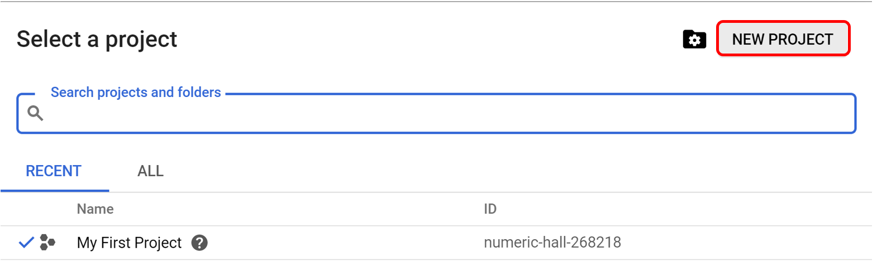
Creating a Project (1/2)
A project is a central repository that is registered to your Google Cloud account.
Each project can contain multiple datasets, and each dataset contains a set of interrelated tables.
At your Home Console, you can see a project called “My First Project”. Click on the drop-down button next to it.
Next, click on “New Project” and type a name for your Project. Each project has a project ID which is often used. (to be continued..)

Slide 9
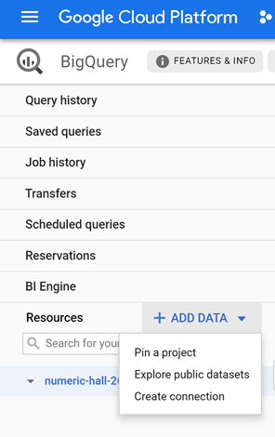
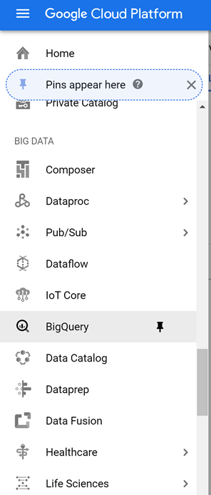
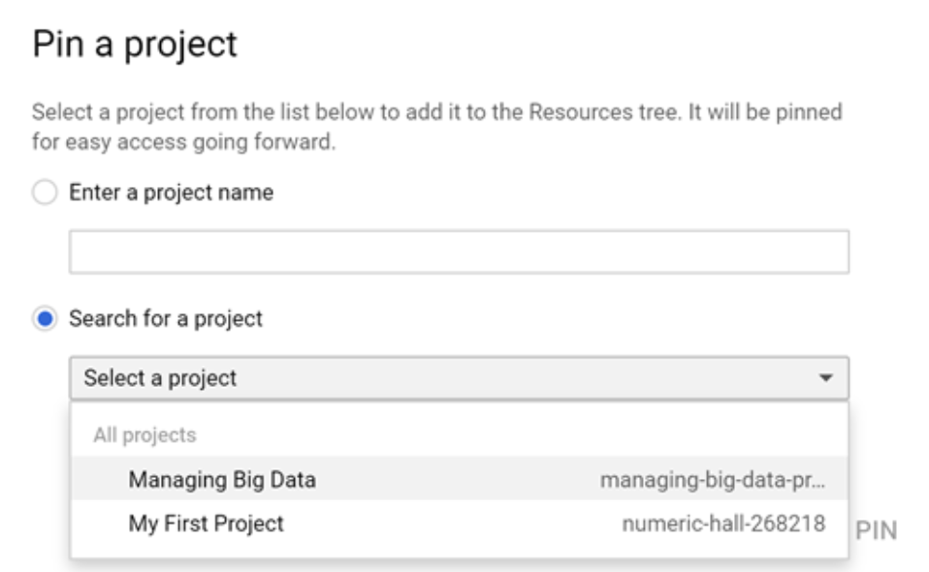
Creating a Project (2/2)
When a project is created, you must pin it within BigQuery.
To do this, click on BigQuery under the Big Data section and pin the project.
You can also use public datasets by “Exploring public datasets” and then choosing a dataset hosted by Google.
You can also pin the public project folder called “bigquery-public-data”.
This folder contains ALL public datasets.

Slide 10
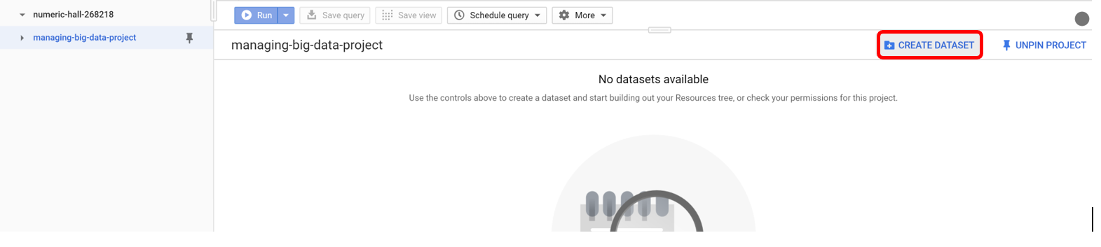
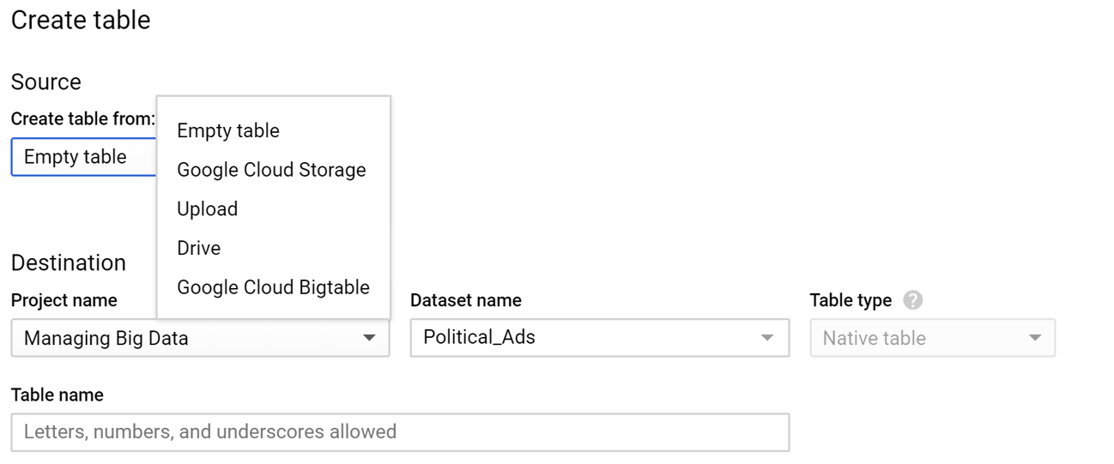
Setting Up a Dataset and Loading Tables
We will create a dataset called “Political_Ads”.
This is a publicly available dataset which we will use later.
When you create a dataset, you can add tables in multiple ways¹:
By using/loading public datasets
By loading data from Google Cloud Storage
By uploading it from a local machine
By inserting records manually
From external data sources, via BigTable
¹ While these are the most common ways of loading tables, this is not an exhaustive list of available options. Refer to https://cloud.google.com/bigquery/docs/tables-intro

Slide 11
Applications & Use Cases

Slide 12
Dataset Introduction – Political Advertising on Google
The dataset has six tables...
For our application demo, we will be using a publicly available dataset that is hosted in BigQuery
The dataset contains information on how much money is spent by verified advertisers on political advertising across Google Ad Services, and demographic targeting used in political ad campaigns by these advertisers are also provided
This dataset is hosted in Google BigQuery and is included in BigQuery's 1TB/month of free tier processing
Each user receives 1TB of free BigQuery processing every month, which can be used to run queries on this public dataset
We will use this dataset in BigQuery to answer two questions related to political advertising campaigns
Which advertisers spend the most on political ad campaigns?
Which advertisers produce the most successful advertisements in the US (as measured by impressions)?
Advertiser_stats
contains spending for each advertiser in various currencies
Advertiser_weekly_spend
contains spending at a weekly level rather than election aggregate
Campaign_targeting
contains spending for each political campaign, its location, and the population targeted (gender, age groups), start and end date
Creative_stats
contains spending for online ads, their URLs, potential spending, impressions, and duration
Geo_stats
Top_keywords_history
contains spending in each country in local currencies
contains keywords with the maximum spending in each election

Slide 13
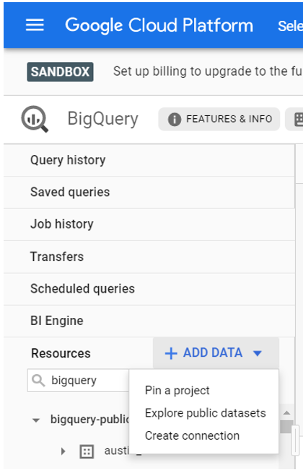
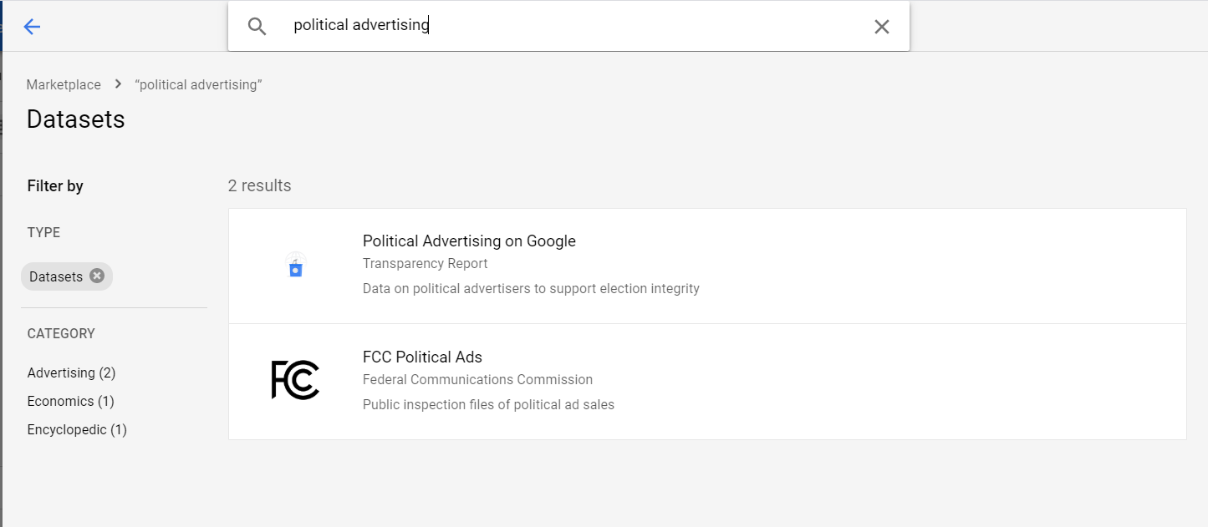
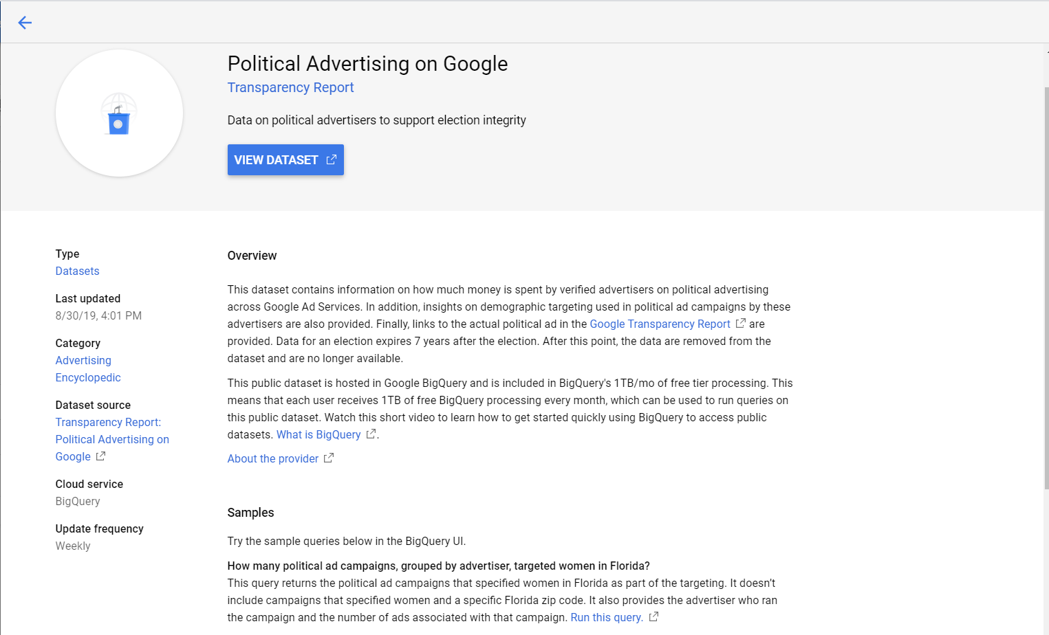
Importing Political Ads data into our project (1/2)
Click on the ‘ADD DATA’ button on the left-hand side of the webpage.
Click ‘Explore public dataset’. A new window will pop out and we can search the name of the dataset we are looking for.
Click on the dataset we want to use to see the data overview.
Click on ‘VIEW DATASET’ to open the dataset folder in BigQuery.

Slide 14
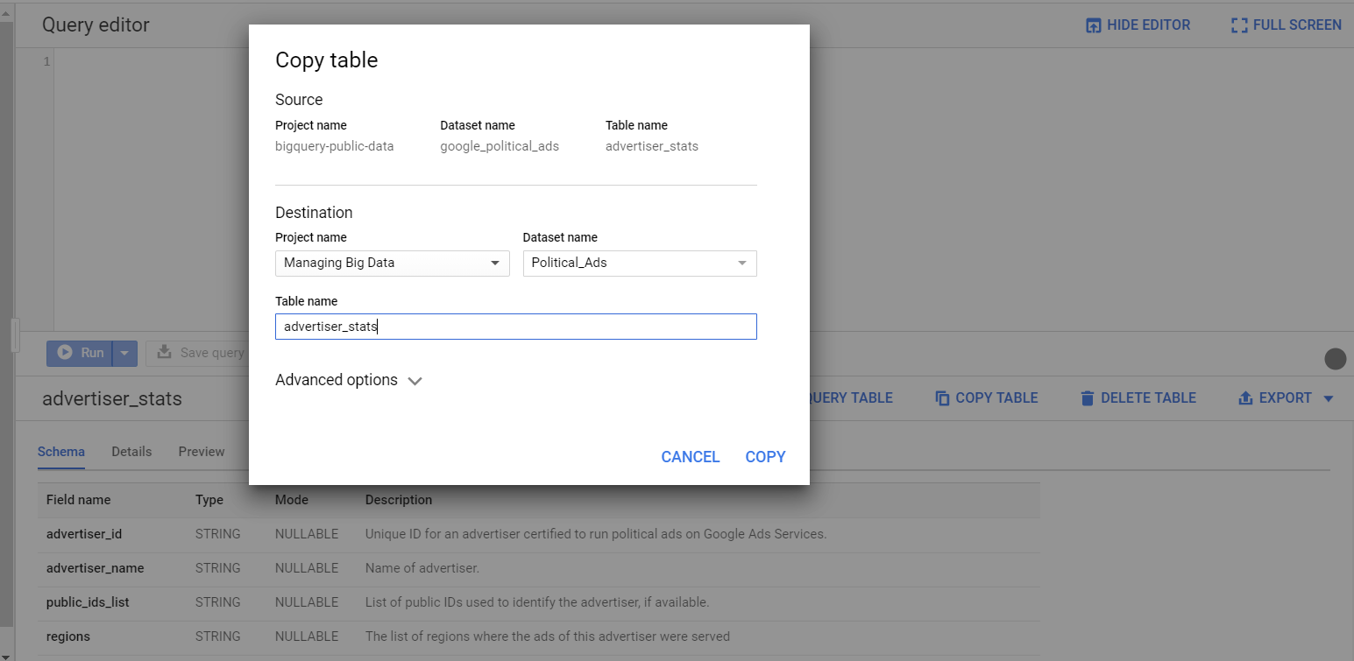
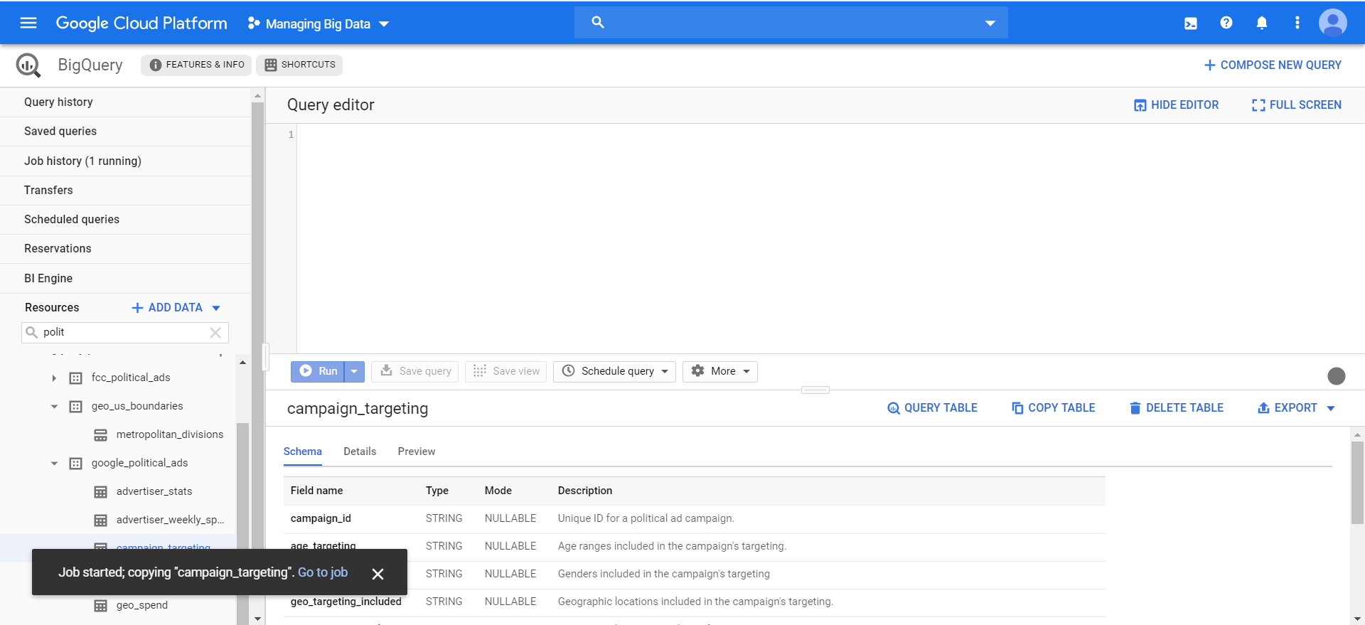
Importing Political Ads data into our project (2/2)
Click on the ‘COPY TABLE’ button and a new window will pop out. Select the Project name and database name that we want the table to be in.
Create a name for the table. It can be the same as the original table since we are creating the table in a different location.
Check the project folder and we can see the table is already been created.

Slide 15
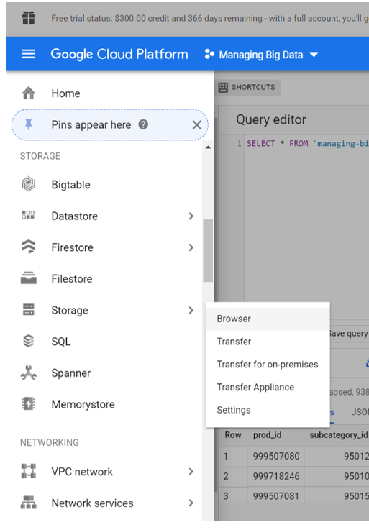
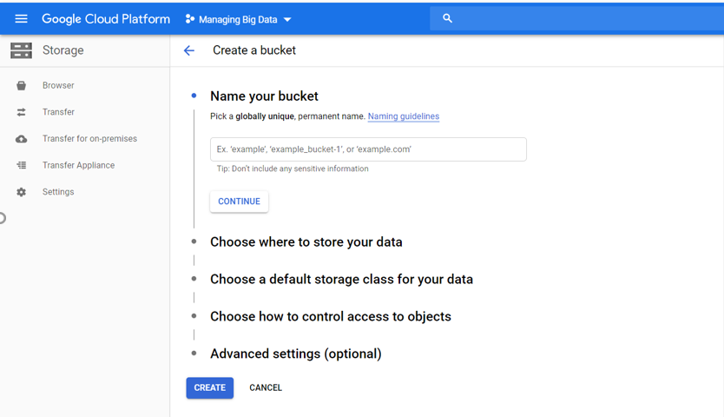
How to Upload Files to Google Cloud Storage
You may want to store your files on the cloud for future use.
You can use GCS to store data in buckets (like AWS’s S3).
Click on the drop-down button on the top-left of the web page and find ‘Storage’.
Click ‘Browser’. As a new user, you will have to create your bucket.
Choose your bucket name & settings.
Click on the bucket name to access the contents of your bucket and click Upload.

Slide 16
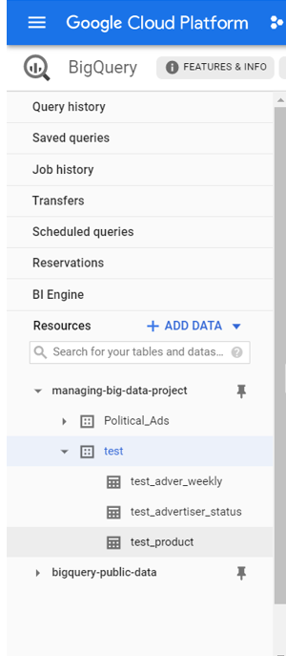
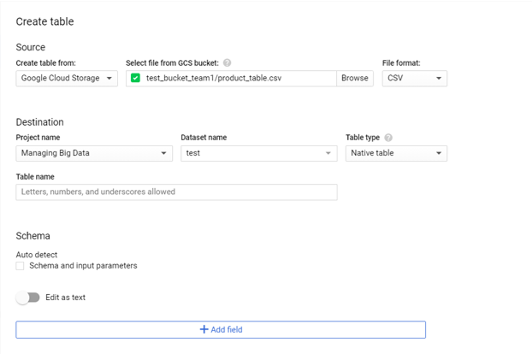
Loading Tables from Google Cloud Storage
Navigate back to BigQuery. Find the project and dataset we want to use, then click ‘CREATE TABLE’.
From ‘Source’, click Google Cloud Storage, then choose the bucket name and locate to the file we want to use.
Choose the Project and Dataset name that we want to create our table in and create a new table name.
GCP can automatically create a schema for your data, or we can create the schema manually.
Click ‘Create table’.

Slide 17
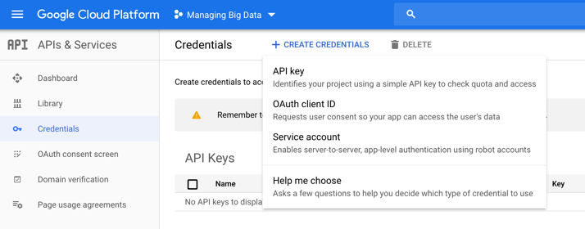
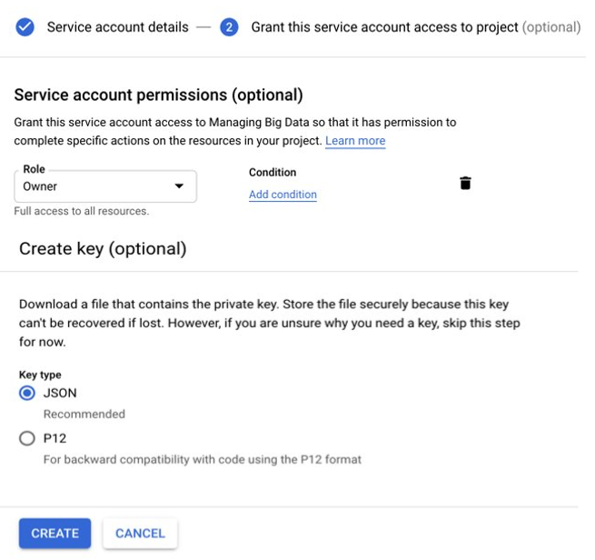
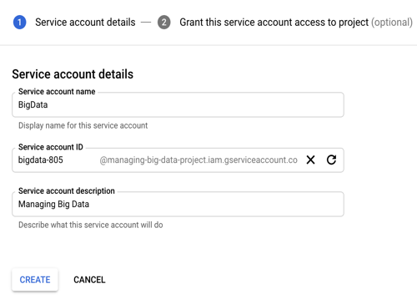
Connecting Python with BigQuery (1/2)
Create Credentials
In order to connect BigQuery with Python, a private key needs to be generated.
This private key will contain the credentials to allow a connection.
To do this, navigate to the API & Service page to create credentials (Service Account).
Type in Service Account name and description.
Set account permissions role as Project Owner to get full access to the database.
Create a JSON key that will be stored locally.

Slide 18
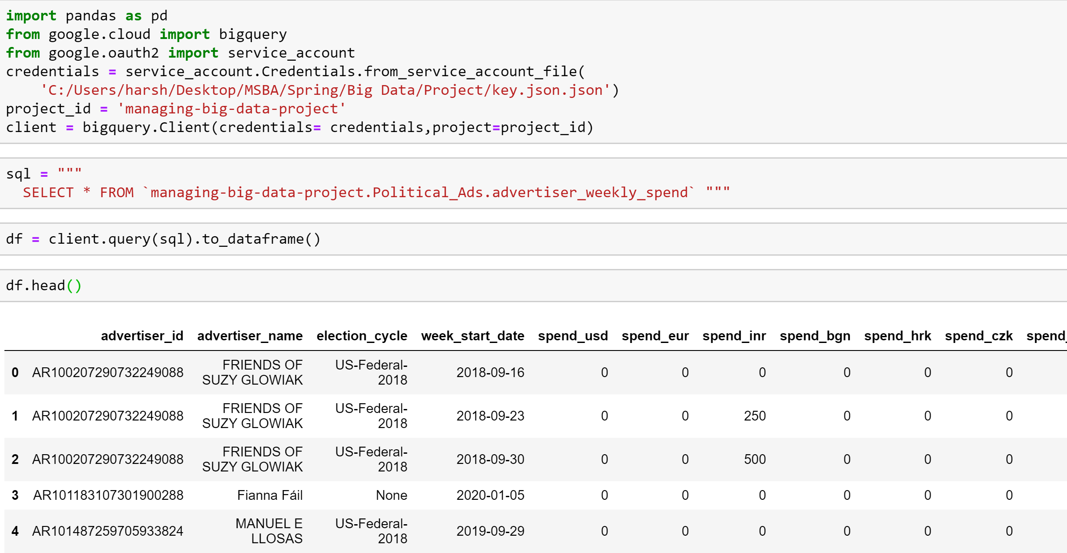
Connecting Python with BigQuery (2/2)
Pre-Requisites
You can now connect your Jupyter notebook on the local machine with BigQuery.
You will need:
Your private key (JSON file) containing credentials to connect to BigQuery
Your unique project-id
You can use simple or complex SQL queries to access the data and store the result of the query in a Pandas dataframe using the client.query function.
The format to access a table is dataset.table name.
bigquery and service_account libraries. Install by running:
pip install --upgrade google-cloud-bigquery
Pandas to store the query result as a dataframe (duh!)

Slide 19
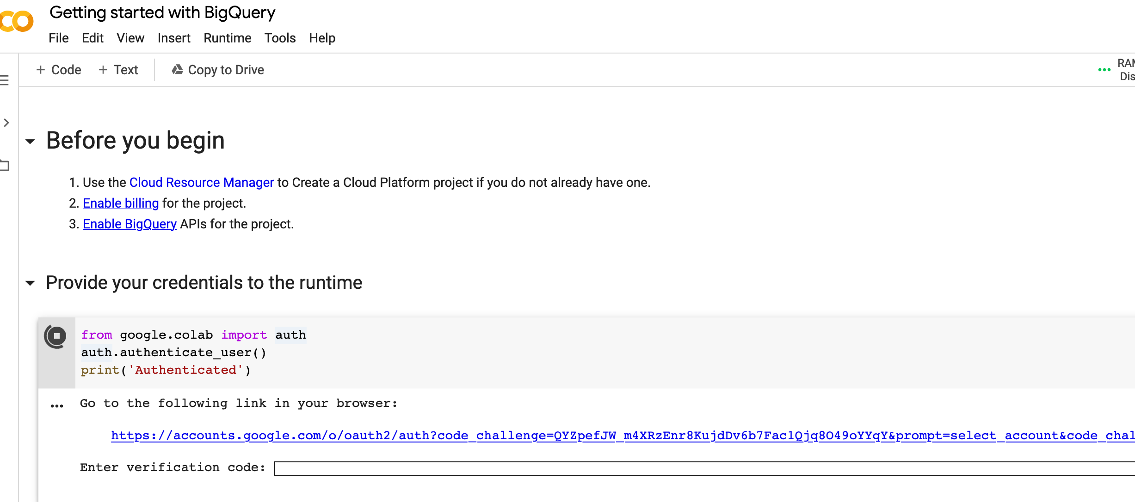
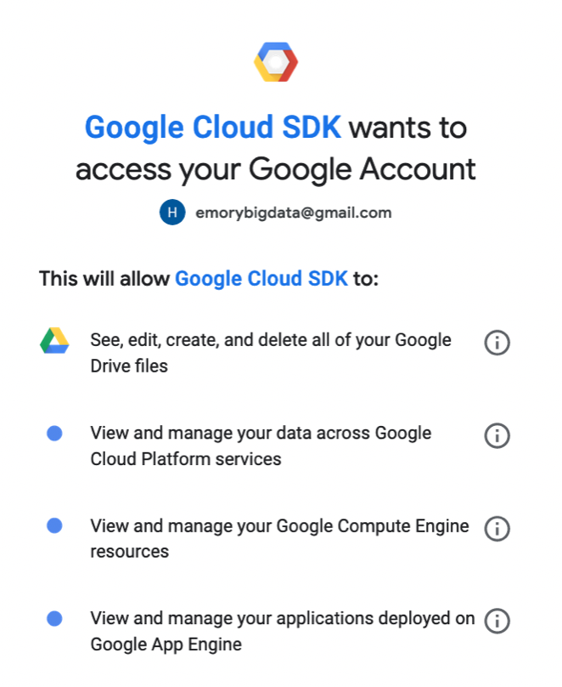
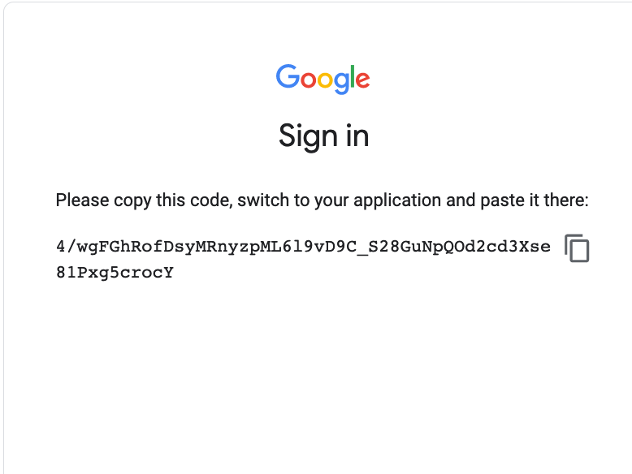
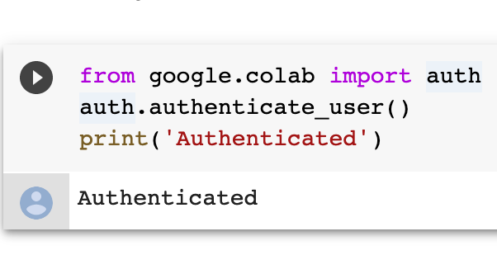
Accessing Data in Colab with BigQuery
Authentication via Google Account
Colab is a Python development environment that runs in your browser using Google cloud.
It supports TensorFlow, BigQuery, and Google Drive.
To access the Google BigQuery, you will first provide the credentials by logging into your Google Account.
Give Google Cloud SKD permission to access your account.
Paste the verification code to the authentication.
Now you are authenticated and ready for the exploration!

Slide 20
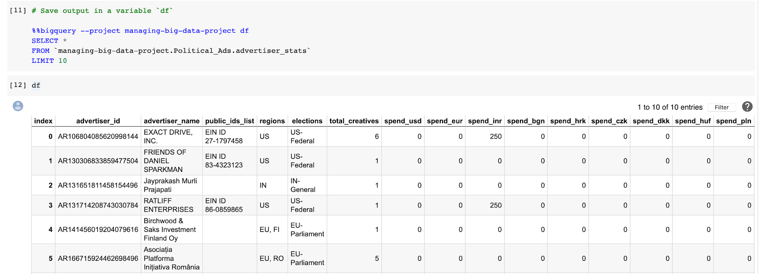
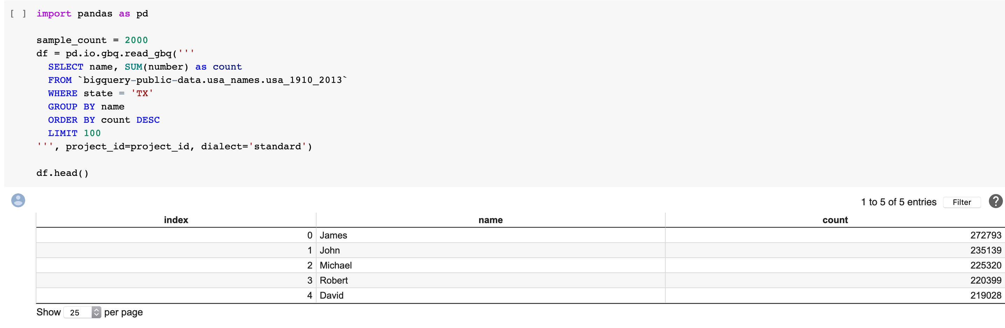
Connecting to BigQuery on Colab
Magic & pandas-gbq
Access the database via Magic. No package required, just provide the project id and query code.
Access the database via google-big-query package. The official package developed by Google.
Access the database via pandas-gbq. Only support basic functions.

Slide 21
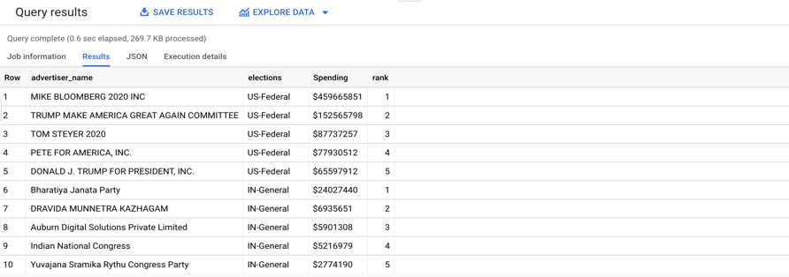
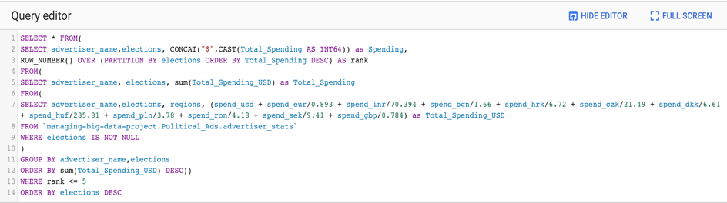
Running Queries within BigQuery:
Find the top advertisers by spending in each election region
Convert all spendings into US dollars
Use Partition and Row_Number to pick top 5 in each region
Change the spending format to US dollars
Group rows by advertiser name
1st : MIKE BLOOMBERG 2020 INC, $459,665,851
2nd: TRUMP MAKE AMERICA GREAT AGAIN COMMITTEE & DONALD J. TRUMP FOR PRESIDENT, INC., $152,565,798
Which advertiser spend the most on political ad campaigns?
You can see the amount of processing & time the query needs
Run complex queries on large datasets in seconds

Slide 22
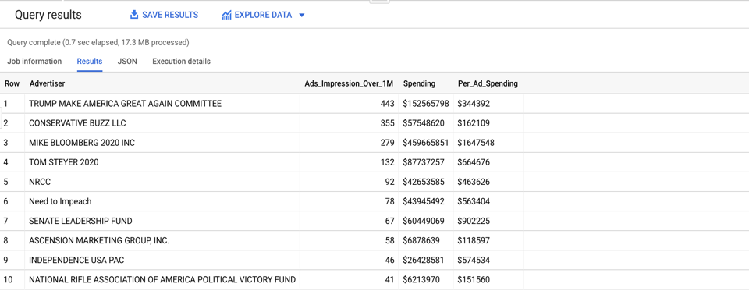
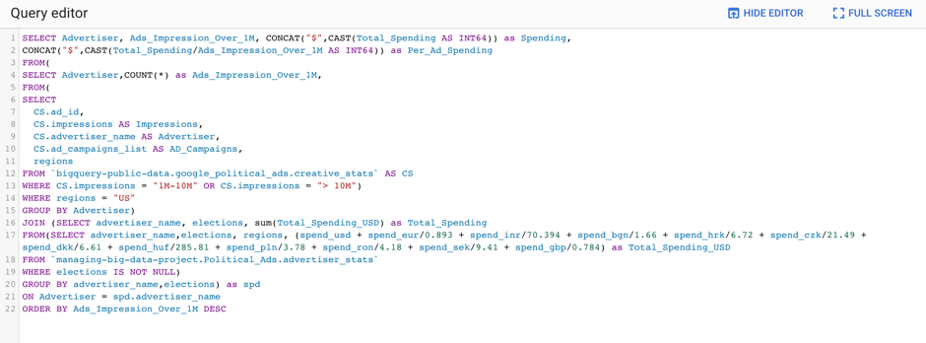
Running Queries within BigQuery:
Retrieve data for advertisements with over 1M Impressions
Which advertisers produce the most successful ads in the US?
We are only looking at those advertisements with impression over 1M.
Locate the ads with column value “1M-10M” and “> 10M”
GROUP BY advertiser name and COUNT total number for each advertiser
TRUMP MAKE AMERICA GREAT AGAIN COMMITTEE has produced 443 influential political advertisements.
Ability to download the query & results as a csv /
Save for future use

Slide 23
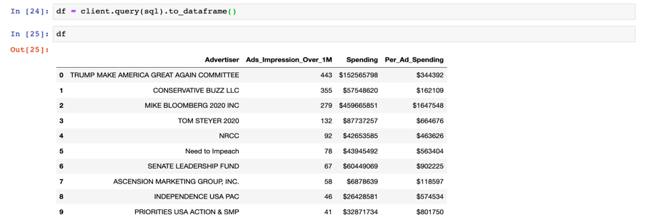
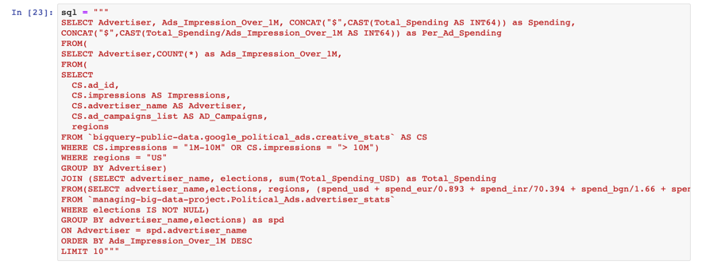
Passing Queries and Retrieving Results within Colab
Evaluate the performance by the cost of advertisement
Instead of loading all tables into Python and then performing manipulation using Pandas, you can pass a query and retrieve processed data for modeling.
The processed data can be stored as a dataframe, just like any raw data.
This is much faster, more convenient, and requires much less memory.
While the SQL code is more complex, it processed and retrieved this information in under 15 seconds.

Slide 24
Final Thoughts

Slide 25
Conclusion & Final Thoughts
BigQuery is a user-friendly, high-speed interactive tool used for querying massive datasets
Developed as an external implementation of Google's Dremel, which sought to improve on key pain points in MapReduce paradigm
Now, Fortune 500s such as Paypal, The Home Depot, & McKesson rely on BigQuery to run hundreds of projects and analyze petabytes of data
We now know how to:
Create a database
Load tables into a database via multiple methods
Load data into a table
Run queries on BigQuery to retrieve data
Connect to BigQuery with Python
It is VERY easy to connect BigQuery with R and Tableau (very similar to Python)
Thanks to BigQuery, we can access information in massive datasets in just seconds at a very low cost!

Slide 26

Thank you!
Questions?

